Slide 1
STUDY EDUCATIONAL OPERATING SYSTEM MINIX OPERATING SYSTEM AND DEVELOP REASONABLY SIZED INTERESTING MODULES FOR THEM
PRESENTED BY,
K.NITHIYA
M.E-CSE

Slide 2
SYNOPSIS
Abstract
Software Requirements
Hardware Requirements
Installation suggestions
Installation of Minix on Vmware From Scratch
Installation of Ethernet Driver for Minix.
Conclusion

Slide 3
ABSTRACT
Study educational operating systems such as Minix Operating System and develop reasonably sized interesting modules for them

Slide 4
SOFTWARE REQUIREMENTS
1)VMWARE 4.5.2.
This shall be provided by Instructor. Kindly ask him for a legal copy. Since this is an Institutional course using pirated copy is illegal.
2) MINIX OPERATING SYSTEM
For the purpose of Installing Minix on Vmware, we shall use Floppy Images of the installation files.
Please download from here and extract to your host machine by Winrar.
Then you have 11 files: root_usr.flp, sys_1.flp, sys_2.flp, usr_1.flp, usr_2.flp, usr_3.flp, cmd_1.flp, cmd_2.flp, cmd_3.flp, net.flp, amd_new.flp With Vmware and Minix Floppy Images, we are all set to install Minix on Vmware.

Slide 5
HARDWARE REQUIREMENTS
512 MB of Memory
Each minix requires 16MB Memory and 200MB hard-disk
0.8GB free hard-disk

Slide 6
INSTALLATION SUGGESTIONS
MINIX need to the following three files:
1.other-flat.zip (VMware disk image, the size is about 7M)
2. other.vmdk
3.other.vmx.
Put these three files into a directory called Minix2.0.4, unzip the other-flat.zip file (you will get a large file called other-flat.vmdk). You can then run this pre-built virtual machine in VMware by loading other.vmx

Slide 7
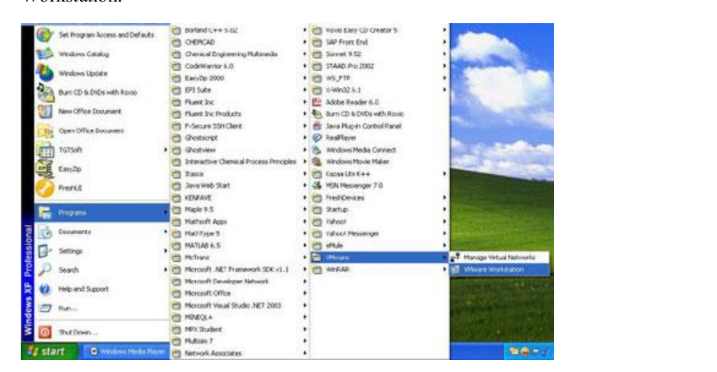
INSTALLATION OF MINIX ON VMWARE FROM SCRATCH
1.Power up Vmware by either clicking on the shortcut on the desktop or either selecting Vmware WorkStation from Programs-->Accessories-->Vmware-->Vmware Workstation.

Slide 8
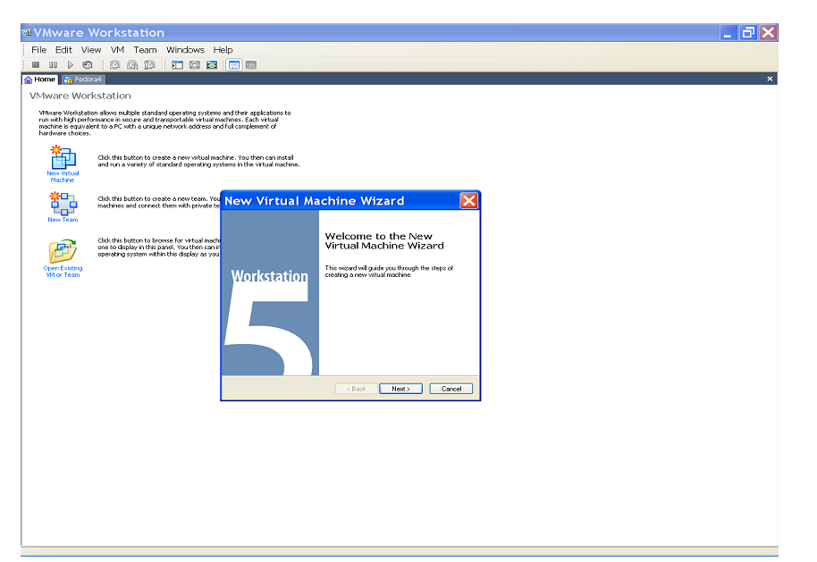
CONDT…..
2.After starting the Vmware WorkStation, click on New Virtual Machine and click Next on the following installation Wizard.

Slide 9
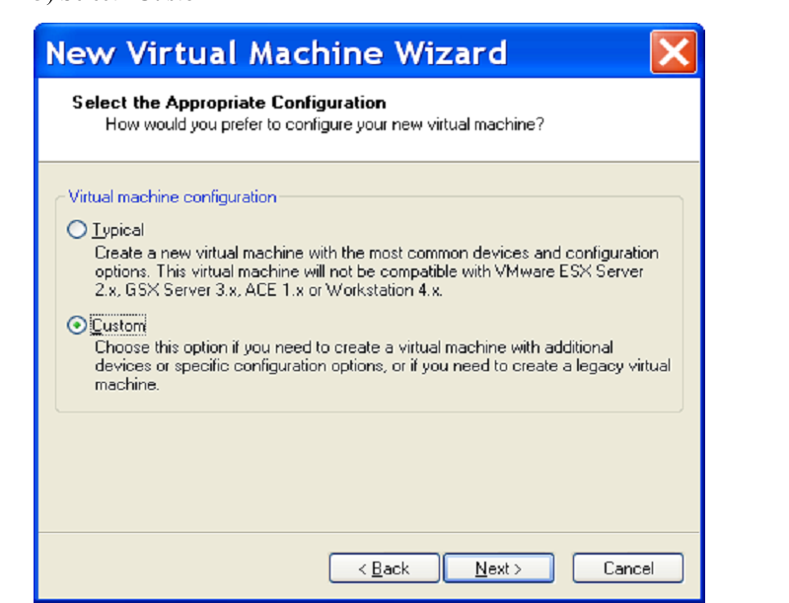
CONDT….
3. Select “Custom”
4. Name the Virtual Machine to be created as Minix1 (or any other self-describing name) and give the path to save the Virtual Machine such as H:\My Virtual Machine\Minix
5. Hit the Next Button and then allocate 16MB RAM
6. Hit the Next Button and Select Network Address Translation (NAT)
7. Select BusLogic (its default) and press Next
8. Check Create a New Virtual Disk and hit Next
9. Select Disk Type as IDE (its Default)

Slide 10
CONDT….
10. Allocate 0.2GB (i.e. 200 MB) of disk space and check mark Allocate All Disk Space now.
11. Specify the Disk File name as Minix1.vmdk (by default it‟s Other.vmdk) and hit Finish.
12. Click on the Edit button and remove Audio, USB controller, CDRom. This step isn‟t necessary but since Minix cant uses them anyways.
13. After that, click on Floppy 1 and from the right hand options, click on Use Floppy Image and Browse to find, folder Floppy 1 and select file root_usr.flp and say OK.
14.Now Click on Start the virtual machine and wait till you get a black screen
15. Once you get the above screen, click on the screen once and then press “=” sign. Note: By Default, Mouse is Windows Hardware, so once you click on the black screen, the mouse freezes and now you can only use your keyboard. To free the mouse again press “Ctrl + Alt”.

Slide 11
CONDT….
16. After you press, “=”, the following screen appears.
17. At the cursor type fd0p2 i.e. mount as /dev/fd0p2 and hit Enter. The screen shown below shall appear after that prompting to input the login.
18. At the login prompt type: root and hit enter. You see a “#” prompt, type setup and hit Enter.
19. After hitting Enter, the following screen appears. Hit Enter again to move on to next screen.
20. Again, hit Enter to move on the next screen.
21. Again, hit Enter to move to another screen.
22. You shall then encounter a screen (after about 4 Enters) for configuring the partition. The screen is shows below.
23. Press “r” to get the present partition.

Slide 12
CONDT…..
24. Move the cursor to line 0 p0 00 none… and then in the last column type 200000 (if you allocate 0.2GB for Minix, here should be 20000) and enter “w” to save the partition. Then enter “y” to save it when prompted.
25.Then press “q” to quit. When prompted type “c0d0p0”after /dev/ i.e. /dev/c0d0p0 and press Enter till you get the screen.
26. Type setup /usr at the “#” prompt and hit Enter until prompted for “input volume 1”
27. Press Ctrl+ Alt to come out of the Minix screen and change the floppy image to point to sys_1.flp under XP and press Enter. After a few setup, you shall be prompted for inserting volume 2 (VM->Removable Devices->Floppy->Edit->Browse->Floppy1->sys_1.flp) .

Slide 13
CONDT…..
28. Follow Step 27 for sys_2.flp. After floppy image points to sys_2.flp
(VM->Removable Devices->Floppy->Edit->Browse->Floppy1->sys_2.flp).
29. You shall see screen similar to the one shown in Step 26.Repeat Step 27 but change the floppy image to point to usr_1.flp and press Enter.
30. (VM->Removable Devices->Floppy->Edit->Browse->Floppy1->cmd_1.flp/ cmd_2.flp /cmd_3.flp).
31. On this “#” prompt type setup / (Note: this time its not setup /usr).
32. After that make the Floppy image point to net.flp.

Slide 14
CONDT….
33.On the hash prompt type
# halt
fd0> boot c0d0p0
login Minix as root
# cd /usr/src/kernel
# make
# cd /usr/src/tools
# make
# make hdboot
# halt
d0p0s0> boot c0d0p0
So far we have finished instillation of Minix, next to add Ethernet

Slide 15
INSTALLATION OF ETHERNET DRIVER FOR MINIX.
1.Open VM->Settings editor, select floppy, unmark “connected at power on”.
2. when power on, just enter „=‟, Minix will bootup.
3. if want to create another Minix virtual machine, just follow the first 13 steps, close VWware, using the existing hard disk file, such as “minix1-flat.vmdk”, which should be 200MB big, to overwrite the other disk file, such as “minix2-flat.vmdk”, you will be all set for a new minix2.
USING FTP TRANSFER DATA:
Using ftp client installed in XP, such as leapFTP, to transfer files between Minix and host machine.
VIRTUAL CONSOLES:
Hold down the ALT key and press the left or right arrow key, F1, or F2. This switches the console between two login sessions.

Slide 16
CONCLUSION
Thus Minix Operating System is installed and verified

Slide 17
THANK YOU

Slide 18
QURIES????

