Slide 1
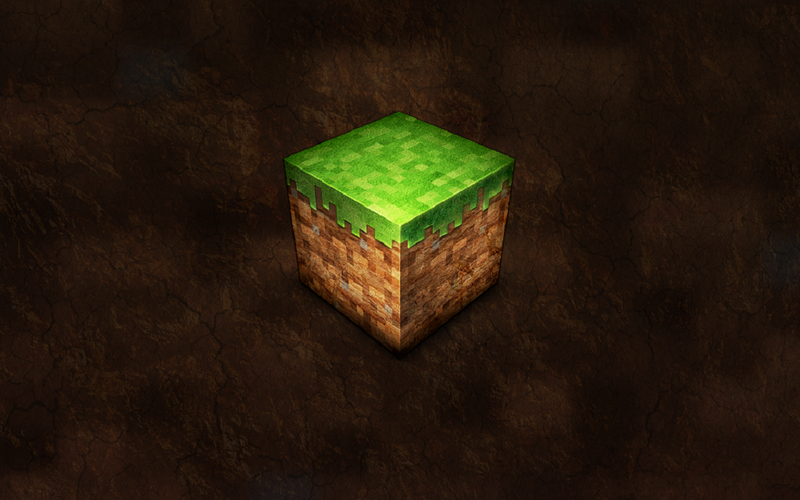

Teaching (with) Minecraft
The Theory

Slide 2
Minecraft Teacher: Joel Levin
Teaches Minecraft in elementary school
  Grade 2
  First Day of Class (11:26, show parts) (link)

Slide 3
Teaching: History
Recreating
  Historic buildings
  Archaeology sites
  Ancient cities
    Even fictional ones

Slide 4
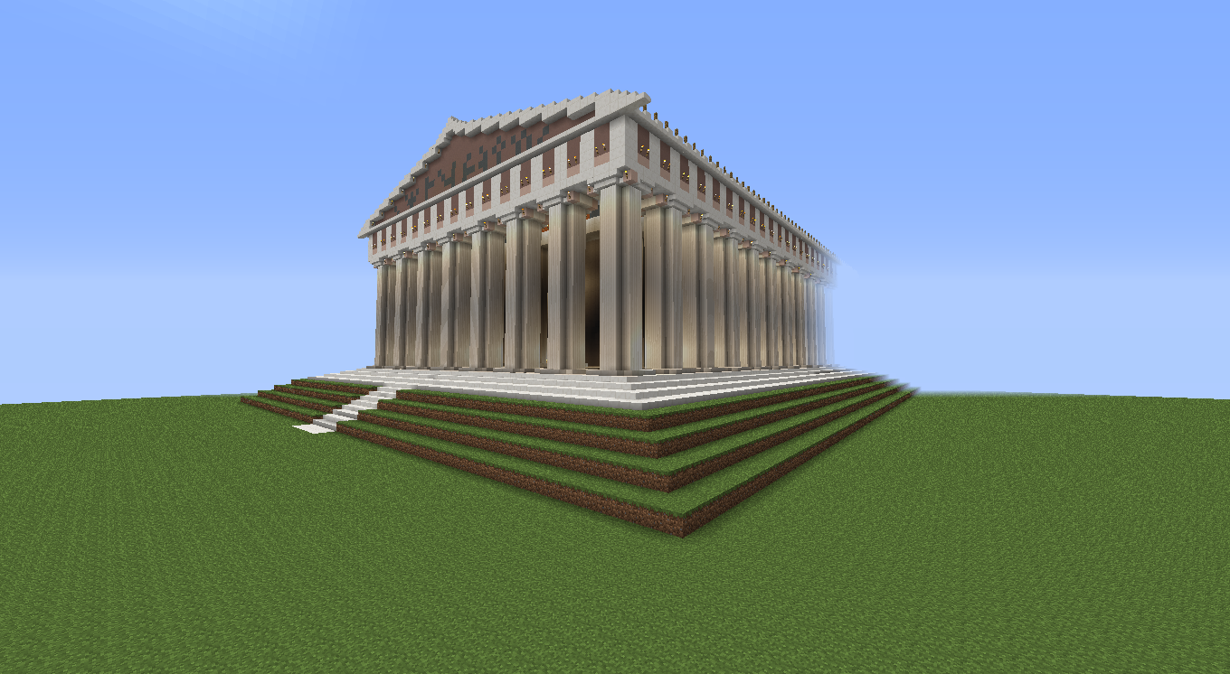
The Parthenon

Slide 5
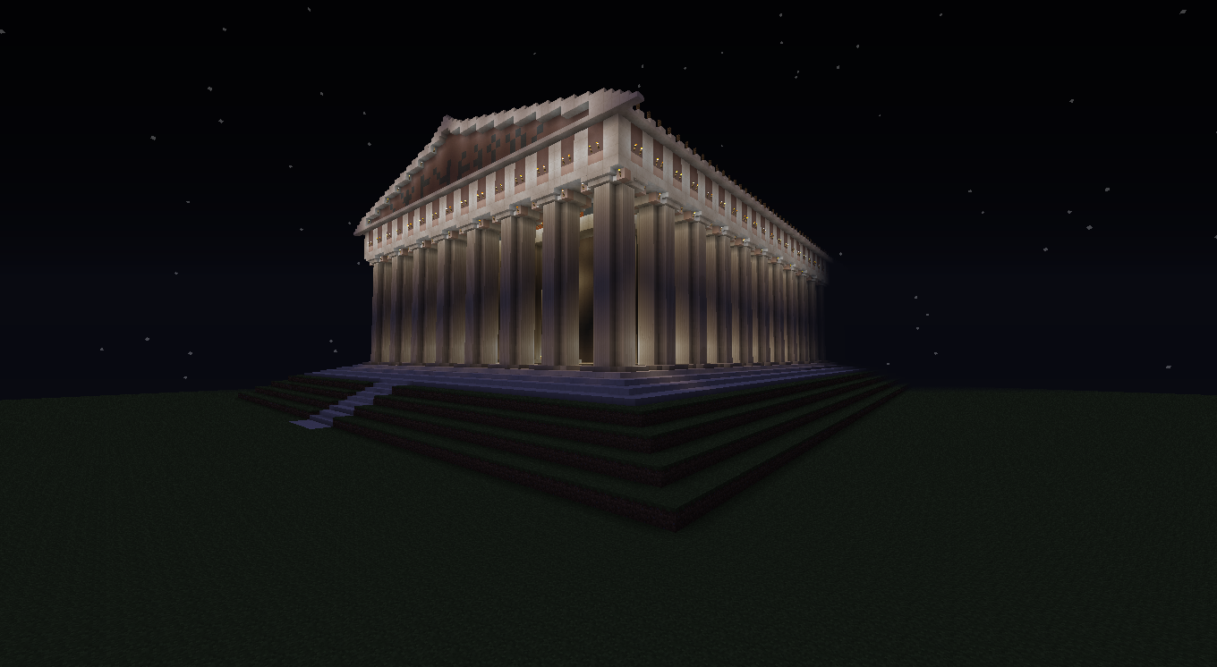

Slide 6
Teaching: Animals
Using Mo’ Creatures Mod
Museum used Dinosaur mod

Slide 7
Teaching: Logic / Electricity
Using Redstone
Allows students to build a circuit using basic gates
  AND, OR, NOT, ETC.
16-bit computer

Slide 8
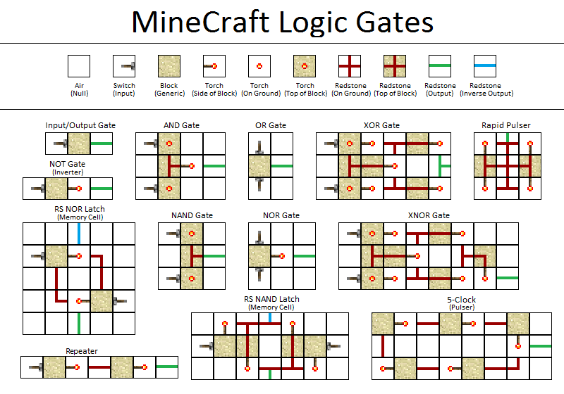

Slide 9
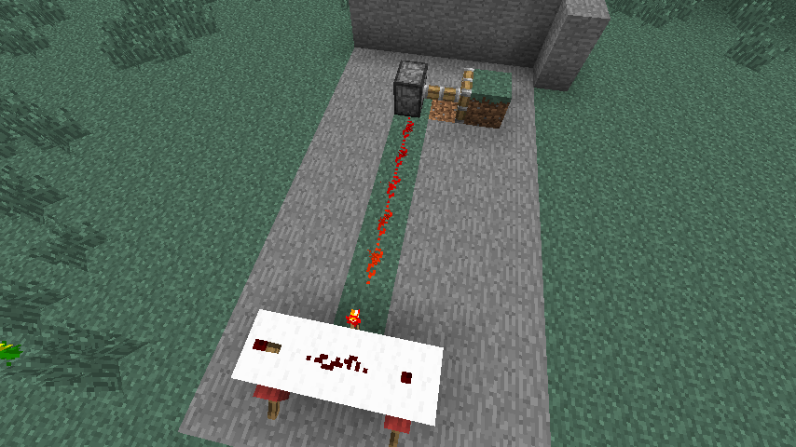
Redstone AND Gate

Slide 10

qCraft – the Quantum Mechanics Mod
  Developed as “a collaboration between Google, E-Line Media, Teacher Gaming and the Institute for Quantum Information and Matter at Caltech”¹

Slide 11
Teaching: Quantum Mechanics
Teaches students about different aspects of Quantum Mechanics - video (3:24)
  Entanglement
  Superposition (the Superpositional Bridge (1:24))
  Observational dependency

Slide 12
Minecraft EDU
Slight Discount for Minecraft Licences
  Must be a recognized education institution
Includes a Mod-ed server
  Lots of benefits for classroom
  http://minecraftedu.com/page/mod
Real World Examples
  http://minecraftedu.com/wiki/index.php?title=Real-world_Examples

Slide 13
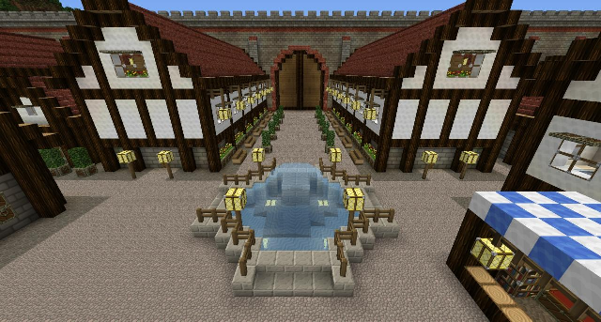
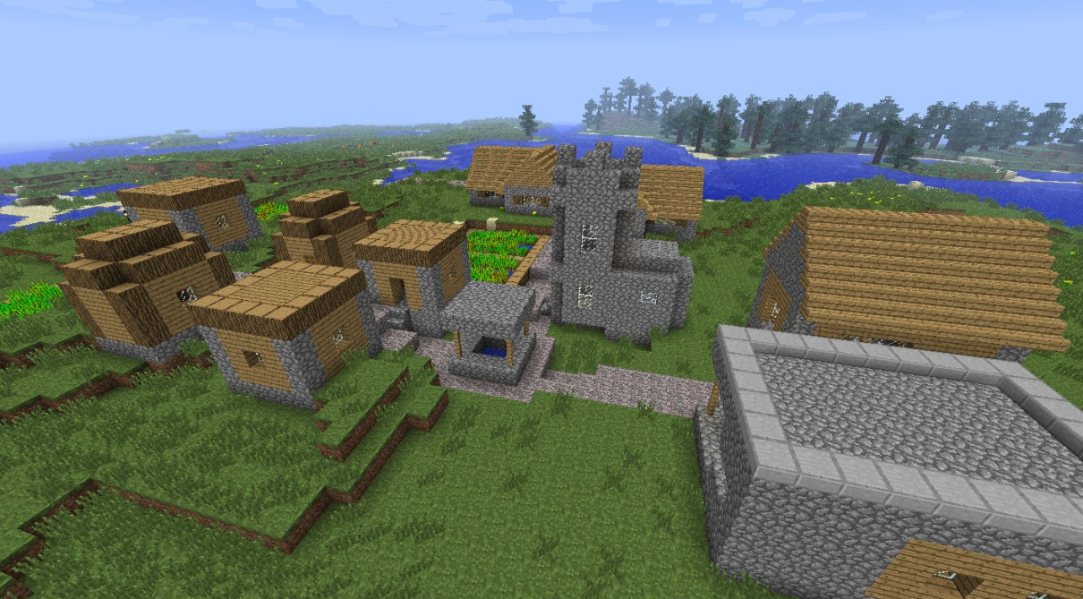
Civics
“I unknowingly started my own virtual communist society.”¹
- Steve Rowley
Garrison Forest School

Slide 14
Literacy
Engages students
Allows them to reflect using a “What I Did Today” writing piece

Slide 15
World Of Humanities (WoH)
A complete, end-to-end solution for exploring middle school curriculum (American)
Students visit ancient Rome, Egypt, Mesopotamia, Babylon
Filled with notes, info, secrets, treasures, and links to websites for real world information
Created by one very dedicated teacher, Eric Walker from the American International School in Kuwaite

Slide 16
WoH: Refugee Camp
Students enter a refugee simulation (losing all items in their inventory) and must scavenge and go on quests to gain food, water, small amounts of money, and building materials.
  http://youtu.be/CjW0i922YN4 (1:04)
    This video is a *must watch*.

Slide 17
Teaching: Computer Programming
Client and servers can be modified (modded)
  Written in Java!
  ScriptCraft using JavaScript to mod
  Some guy working on Python but nothing yet
Actually programming inside Minecraft:
  ComputerCraft (link)
    Programming in LUA
    Programmable Turtles (2:09)(http://youtu.be/n_L8RE26twM)

Slide 18
How To Mod
Using MCreator: http://mcreator.pylo.si/
  Requires no programming
    V1.6.4 (link)
  Change/create textures, foods, crafting recipes, mobs,

Slide 19
Writing Server Mods
One technique uses Bukkit API
Not officially supported by Mojang
  They just let it happen.
Always a few versions behind.
A few other techniques available
  Minecraft Coder Pack (MCP) may be a simple way to start: http://mcp.ocean-labs.de/page.php?4

Slide 20
Writing Server Mods
Written in Java using Bukkit API
  Examples in the next slides come from the instructions in Building Minecraft Server Mods by Cody M. Sommer

Slide 21
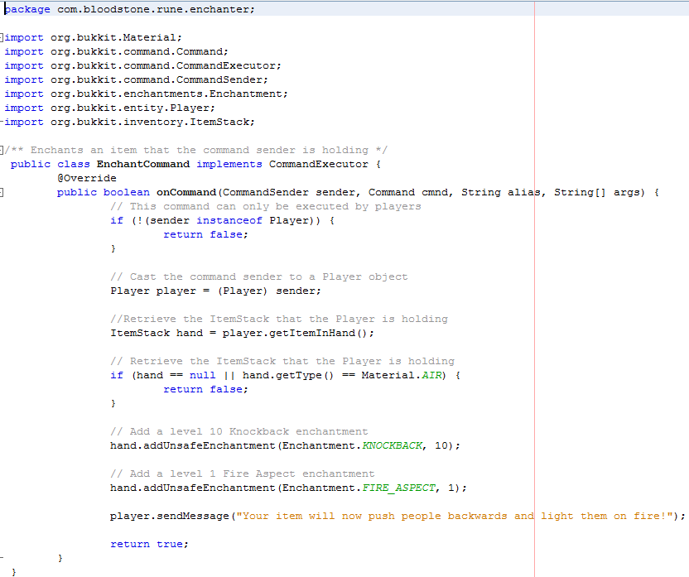
ca.wlu.rhenderson

Slide 22
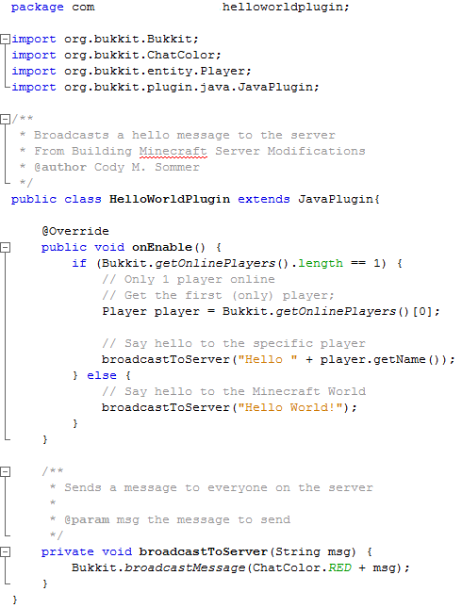

Slide 23
Video Links
qCraft – Schrödinger's Cat: http://youtu.be/0lsEqTaRj9c (1:49)

Slide 24
Articles
Introducing Kids to Java Programming (link)
ScriptCraft – a JavaScript wrapper for Minecraft (link)

Slide 25
Books
Building Minecraft Server Modifications
  (link)

Slide 26
Teacher Resources
Minecraft Teachers Google Group
  https://groups.google.com/forum/#!forum/minecraft-teachers
GamingEducators (Toronto, Guelph, etc.):
  http://www.gamingedus.org/

Slide 27
