Slide 1
COMPLEX NUMBERS
and
QUADRATIC EQUATIONS

Slide 2
Complex Numbers
Consider the quadratic equation x² + 1 = 0.
Solving for x , gives x² = – 1
We make the following definition:

Slide 3
Note that squaring both sides yields:
therefore
and
so
and
And so on…

Slide 4
Real numbers and imaginary numbers are subsets of the set of complex numbers.
Complex Numbers
Real Numbers
Imaginary
Numbers

Slide 5
Definition of a Complex Number
If a and b are real numbers, the number a + bi is a complex number, and it is said to be written in standard form.
If b = 0, the number a + bi = a is a real number.
If a = 0, the number a + bi is called an imaginary number.

Slide 6
Addition and Subtraction of Complex Numbers
If a + bi and c +di are two complex numbers written in standard form, their sum and difference are defined as follows.
Sum:
Difference:

Slide 7
Addition of complex no.s satisfy the following properties:
1.The closure law: z₁ + z₂ is complex no. for all complex no.s z₁ and z₂.
2.The comutative law: For any complex no. z₁ and z₂, z₁ + z₂= z₂+ z₁.
3.The associative law: For any 3 complex no.s z₁, z₂, z₃, (z₁ + z₂)+ z₃ = z₁ +(z₂+ z₃).
4.The existence if additive identity: There exists the comlex no. 0+i0,called the additive idntity or zero complex no.,such that ,for every complex no. z,z+0=z.
5.The existence of additie inverse: To every complex no. z=a+ib,we have the complex no. -z=
-a+i(-b),called the additive inverse or negative of z.
z+(-z)=0.

Slide 8
Multiplying Complex Numbers
Multiplying complex numbers is similar to multiplying polynomials and combining like terms.
For Example :-. ( 6 – 2i )( 2 – 3i )
12 – 18i – 4i + 6i²
12 – 22i + 6 ( -1 )
6 – 22i

Slide 9
The multiplication of complex no.s possess the following properties
THE CLOSURE LAW- The product of two complex numbers is a complex number , the product z₁ z₂ is a complex number for all complex numbers z₁ and z₂
THE COMMUTATIVE LAW- For any two complex numbers z₁ and z₂
z₁ z₂ ₌ z₂ z₁
THE ASSOCIATIVE LAW – For any three complex numbers z₁ ,z_{2 ,} z₃
₍z₁ z₂ ₎ z₃ = z₁ (z₂ z₃ )
THE EXISTENCE OF MULTIPLICATIVE IDENTITY- There exists the complex number 1+i0 ( denoted as 1 ) , called the multiplicative identity such that z.1 = z , for every complex numbers z
DISTRIBUTIVE LAW – For any three complex numbers z₁ ,z_{2 ,} z₃
z₁ (z₂ ₊ z₃) = z₁z₂ + z₁z₃
(z₁ ₊ z₂ ) z₃ = z₁z₃+ z₂z₃

Slide 10
DIVISION OF COMPLEX NUMBERS
Let z₁ and z₂ be 2 complex no.s,where z₂‡0,the quotient z₁/z₂ is defined by z₁/z₂=z₁ 1/z₂.
Example:z₁=6+3i and z₂=2-i
z₁/z₂=((6+3i)×1/2-i)=(6+3i)(2/2²+(-1)²+i –(-1)/2²+(-1)²)
=(6+3i)(2+5/i)=1/5(12-3+i(6+6))=1/5(9+12i).

Slide 11
THE SQUARE ROOTS OF A NEGATIVE REAL NUMBER
i²=-1 and (-i)²=i= -1.Therefore,the square roots of -1 are i,-i. However by the symbol √-1,we would mean i only.
Now,we can see I and –iboth are solutions of the equation x²+1=0 or x²= -1.
Similarly ,(√3i)²=(√3)²i²=3(-1)= -3.
(- √3i)²=( - √3)²i²= -3
Therefore the square roots of -3 are √3i and - √3i.
Again the symbol √-3 is meant to represent √3i only,i.e.,
√-3= √3i.
Therefore , √a× √b ‡ √ab if both a and b are negative real no.s.
Further if any of a or b is zero,then,√a× √b= √ab=0.

Slide 12
IDENTITIES
1.(z₁=z₂)²=z₁²+z₂²+2z₁z₂.
2.(z₁-z₂)²=z₁²+z₂²-2z₁z₂.
3.(z₁+z₂)³=z₁³+z₂³+3.z₁. z₂(z₁+z₂).
4.(z₁-z₂)³=z₁³-z₂³-3. z₁. z₂(z₁-z₂).
5. z₁²-z₂²= (z₁+z₂)(z₁-z₂).
All identities which are true for real no.s can also be proved true for all complex no.s.

Slide 13
THE MODULUS AND CONJUGATE OF A COMPLEX NUMBER
Let z = a + ib be a complex number. Then, the modulus of z, denoted by | z |, is defined to be the non-negative real number √a² + b² , i.e., | z | = √a² + b² and the conjugate of z, denoted as z , is the complex number a – ib, i.e., z = a – ib.
For example, |3 + i| = √3² +1² = √10

Slide 14
Conjugate

Slide 15
Conjugate Theorems
The conjugate of the conjugate of a complex number is the complex number itself
The conjugate of the sum of two complex numbers equals the sum of their conjugates
The conjugate of the product of two complex numbers equals the product of their conjugates.

Slide 16
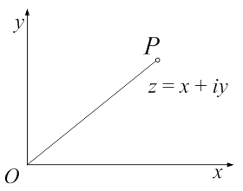
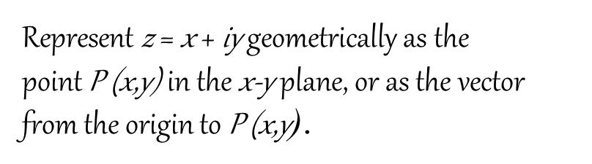
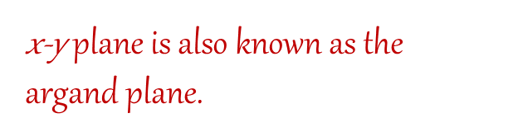
Complex Plane
A complex number can be plotted on a plane with two perpendicular coordinate axes
  The horizontal x-axis, called the real axis
  The vertical y-axis, called the imaginary axis

Slide 17



Graphing in the complex plane

Slide 18
QUADRATIC EQUATIONS
Let us consider the following quadratic equation:
ax² + bx + c = 0 with real coefficients a, b, c and a ≠ 0.
Also, let us assume that the b² – 4ac < 0. Now, we
know that we can find the square root of negative
real numbers in the set of complex numbers.
Therefore, the solutions to the above equation are
available in the set of complex numbers which are given
by x= -b±√b²-4ac/2a= -b±√4ac-b²i/2a.
A polynomial equation of degree n has n no. of roots.

Slide 19
Example:--
(i) x²+2=0
x²= -2 x=±√-2 x=±√2 i.
(ii) x²+x+1=0
b² -4ac=1-4.1.1= -3
x= -1±√-3/2x1
x= -1±√3 i/2.

