Slide 1


Slide 2
PRESENTATION BY
OSAMA TAHIR
09-EE-88

Slide 3
COMPLEX NUMBERS
&
COMPLEX PLANE

Slide 4
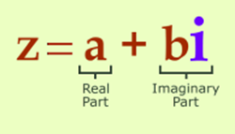
COMPLEX NUMBERS
A complex number is a number consisting of a Real and Imaginary part.
It can be written in the form

Slide 5
COMPLEX NUMBERS
Why complex numbers are introduced???
Equations like x2=-1 do not have a solution within the real numbers

Slide 6
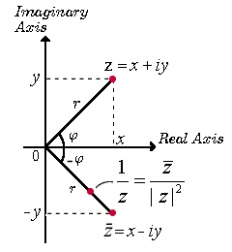
COMPLEX CONJUGATE
The COMPLEX CONJUGATE of a complex number
z = x + iy, denoted by z* , is given by
z* = x – iy
The Modulus or absolute value
is defined by

Slide 7
COMPLEX NUMBERS
Real numbers and imaginary numbers are subsets of the set of complex numbers.
Complex Numbers
Real Numbers
Imaginary
Numbers

Slide 8
COMPLEX NUMBERS
Equal complex numbers
Two complex numbers are equal if their
real parts are equal and their imaginary
parts are equal.
If a + bi = c + di,
then a = c and b = d

Slide 9
ADDITION OF COMPLEX NUMBERS
EXAMPLE

Slide 10
SUBTRACTION OF COMPLEX NUMBERS
Example

Slide 11
MULTIPLICATION OF COMPLEX NUMBERS
Example

Slide 12
DIVISION OF A COMPLEX NUMBERS

Slide 13
EXAMPLE

Slide 14
COMPLEX PLANE
A complex number can be plotted on a plane with two perpendicular coordinate axes
  The horizontal x-axis, called the real axis
  The vertical y-axis, called the imaginary axis
x-y plane is known as the complex plane.
The complex plane

Slide 15
COMPLEX PLANE
Geometrically, |z| is the distance of the point z from the origin while θ is the directed angle from the positive x-axis to OP in the above figure.
θ is called the argument of z and is denoted by arg z. Thus,

Slide 16
Expressing Complex Number
in Polar Form
So any complex number, x + iy, can be written in
polar form:

Slide 17
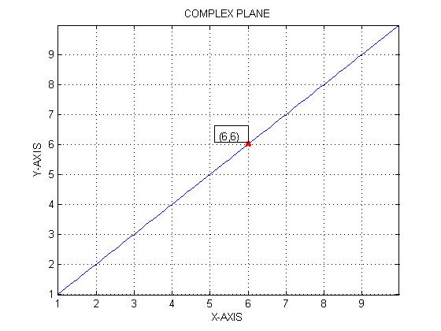
Imaginary axis
Real axis

Slide 18
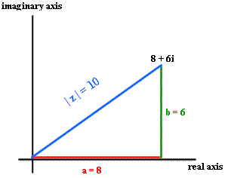
De Moivre’s Theorem
De Moivre's Theorem is the theorem which shows us how to take complex numbers to any power easily.
Let r(cos Φ+isin Φ) be a complex number and n be any real number. Then
[r(cos Φ+isin Φ]^{n} = r^{n}(cosnΦ+isin nΦ)
[r(cos Φ+isin Φ]^{n} = r^{n}(cosnΦ+isin nΦ)

Slide 19
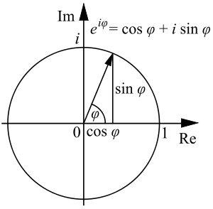
Euler Formula
The polar form of a complex number can be rewritten as
This leads to the complex exponential
function :

Slide 20
Example
A complex number, z = 1 - j
has a magnitude
and argument :
Hence its principal argument is :
rad
Hence in polar form :

Slide 21


APPLICATIONS
Complex numbers has a wide range of
applications in Science, Engineering,
Statistics etc.
Applied mathematics
Solving diff eqs with function of complex roots
Cauchy's integral formula
Calculus of residues
In Electric circuits
to solve electric circuits

Slide 22

How complex numbers can be applied to “The Real World”???
Examples of the application of complex numbers:
Electric field and magnetic field.
Application in ohms law.
In the root locus method, it is especially important whether the poles and zeros are in the left or right half planes
A complex number could be used to represent the position of an object in a two dimensional plane,

Slide 23





REFERENCES..
Wikipedia.com
Howstuffworks.com
Advanced Engineering Mathematics
Complex Analysis

Slide 24

ANY QUESTIONS.....????

Slide 25
THANK YOU
FOR YOUR ATTENTION..!

