Slide 1



Christianity, islam, and judaism
By: Benedict Gombocz

Slide 2

Christianity
Followers are known as Christians
Currently has 2 billion followers
Largest religion in the world
Major religion in Europe and North and South America with rapid growth in Africa
Sacred text is the Bible (both Old and New Testaments)
Other written authority is church fathers, church councils, and papal degrees (Catholic only)
Religious law (only for Catholics) is Canon Law
Clergy is priests, ministers, pastors, and bishops

Slide 3
Christianity – cont.
Houses of worship are churches, chapels, and cathedrals
Main day of worship is Sunday
Separates church and state

Slide 4
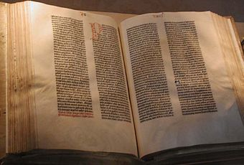
The Bible

Slide 5

Church

Slide 6

Islam
Followers are known as Muslims
Currently has 1.3 billion followers
2nd largest religion in the world
Major religion in the Middle East and Southeast Asia
Scared text is the Qur’an (Koran)
Other written authority is the Hadith
Religious law is Sharia
Clergy is Imams
House of worship is a mosque
Main day of worship is Friday
Integrates church and state

Slide 7
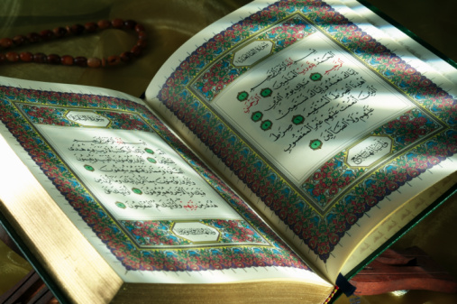
The Qur’an (Koran)

Slide 8
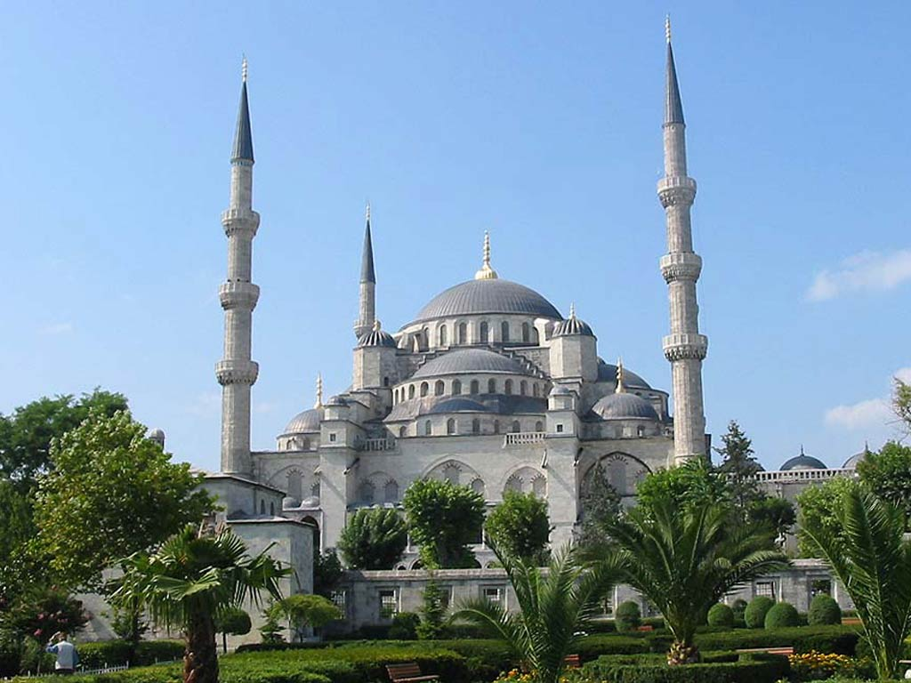
Mosque

Slide 9
Judaism
Followers are known as Jews
Currently has 14 million followers
12th largest religion in the world
Major religion in Israel, Europe, and the United States
Sacred text is the Bible, called the Torah (Old Testament only)
Other written authority is Talmud, Midrash, and Responsa
Religious law is Halakah
Clergy is Rabbis
House of worship is a synagogue
Main day of worship is Saturday
Separates church and state

Slide 10
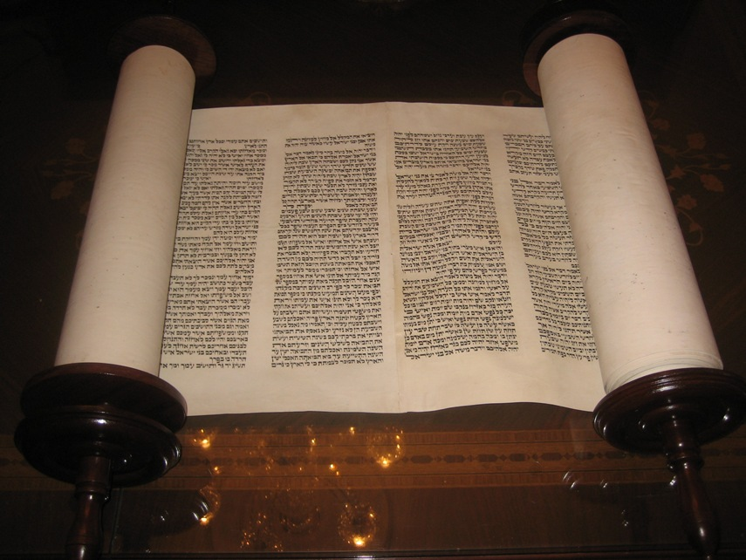
The Torah

Slide 11
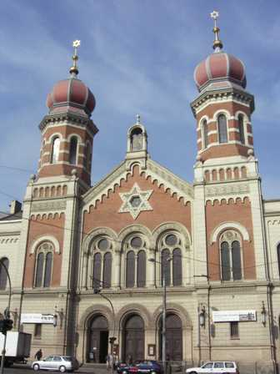
Synagogue

Slide 12
Comparison: Origins and History
Date founded: 622 CE (Islam); 1800 BCE (Judaism); c. 33 CE (Christianity)
Place founded: present-day Saudi Arabia (Islam); present-day Israel and Palestine (Judaism and Christianity)
Founder or prophet: Muhammad (Islam); Moses or Abraham (Judaism); Jesus (Christianity)
Original language(s): Arabic (Islam); Hebrew (Judaism); Aramaic and Greek (Christianity)
Early expansion: within 12 years in the entire Arabian peninsula; within a century, the Muslim world expanded from the Atlantic to China (Islam); very little expansion; mostly only to Palestine (Judaism); within 60 years to major cities in Palestine, Turkey, Greece and Rome; the whole Roman Empire by the close of the 4th century CE (Christianity)

Slide 13

Comparison: Common and differing beliefs
Islam and Judaism are strict monotheistic; Christianity is Trinitarian monotheistic
Believe in only one God- the only common belief among the three faiths
Names for God are Allah (Islam), Yahweh and Elohim (Judaism), and the Holy Trinity (Christianity)
All three faiths share two common other spiritual beings (angels and demons) but Islam has one the other two do not- jinn
Islam and Judaism have one revered human in common- prophets; Christianity has saints and church fathers
Identify of Jesus: True prophet of God whose message has been corrupted (Islam), false prophet (Judaism), and the Son of God, God incarnate, and savior of the world (Christianity)
Judaism and Christianity share a common belief on the death of Jesus that he was crucified; Islam believes he did not die, but ascended into heaven during crucifixion

Slide 14
Comparison: Common and differing beliefs – cont.
Islam and Judaism deny the resurrection of Jesus; Christianity affirms it
Islam and Christianity affirm the second coming of Jesus; Judaism denies it
Divine revelation: through Muhammad and recorded in the Qur’an (Islam); through Prophets and recorded in the Torah (Judaism); through Prophets and Jesus (as God Himself) recorded in the Bible (Christianity)
Views of sacred text: inspired, literal word of God, inerrant in original languages (Islam); views vary (Judaism); inspired and some believe inerrant in original languages (Christianity)
Differing beliefs on human nature: equal ability to do good or evil (Islam); two equal impulses- one good and one bad (Judaism); “original sins inherited from Adam – tendency towards evil (Christianity)
The three faiths have one common means of salvation- good deeds
God’s role in salvation is predestination in Islam; divine revelation and forgiveness in Judaism; and predestination and various forms of grace in Christianity

Slide 15
Comparison: Common and differing beliefs – cont.
Beliefs in good afterlife: everlasting paradise (Islam); views vary: either heaven or no afterlife (Judaism); everlasting heaven (Christianity)
Beliefs in bad afterlife: everlasting hell (Islam); views vary: either everlasting Gehenna, reincarnation, or no afterlife (Judaism); everlasting hell or temporary purgatory (Christianity - Catholicism only)
Different interpretations on fellow and related Abrahamic religions: Muslims view Jews and Christians as “People of the Book” but they have incorrect beliefs and only partial revelation; Jews view Islam and Christianity as false interpretations and extensions of their religion; Christians see Judaism as a true religion, but only with incomplete revelation; and Islam as a completely false religion

Slide 16
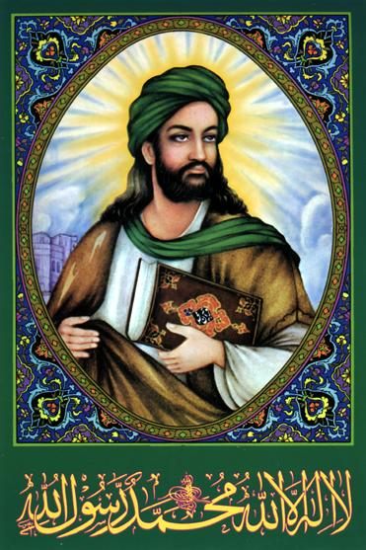
Muhammad

Slide 17
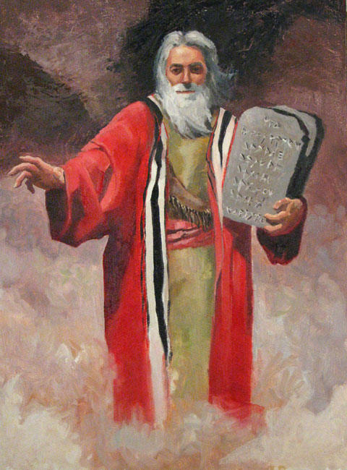
Moses

Slide 18
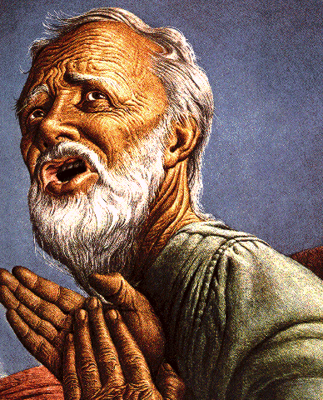
Abraham

Slide 19
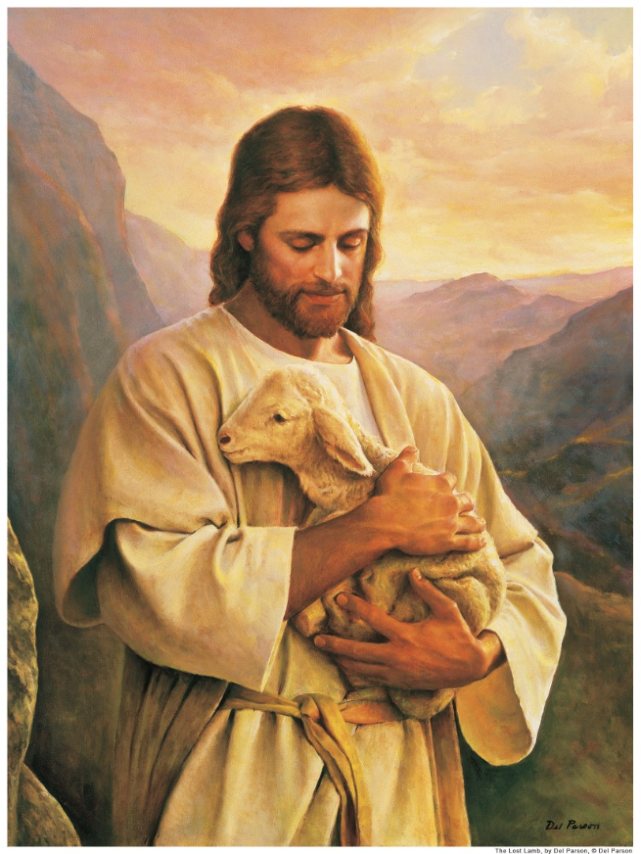
Jesus

Slide 20
Christianity: Denominations
Catholic
Orthodox
Protestant
  Lutheran
  Calvinist
  Anglic
  Baptist
Non-Trinitarian
  Unitarian Universalist Christians
  Bible Students
  Christadelphians
  Christian Scientists

Slide 21
Christianity: Denominations – cont.
Friends General Conference
Iglesia ni Cistro
Jehovah’s Witnesses
Latter Day Saints
Oneness Pentecostals
United Church of God

Slide 22
Islam: Denominations
Sunni
Shia
Sufism
Minor denominations
  Ahmadiyya
  Ibadi
  Qurantists
  Yazdânism
  Nation of Islam

Slide 23
Judaism: Religious Movements
Orthodox Judaism (Hareidi Judaism and Modern Orthodox Judaism)
Conservative Judaism
Reform Judaism

Slide 24
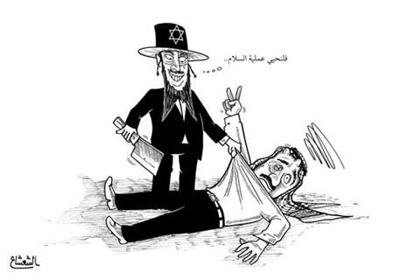
Tense relationship among the three faiths
In spite of common beliefs and teaches, the three faiths have an uneasy and poor relationship amongst each other
This is evident through one faith’s views on the other two; false stereotypes of all three have also escalated discrimination
For example, followers of all three faiths- Jews in particular- suffered discrimination and persecution for their beliefs and practices for centuries, which saw recurring instances of pogroms
Common stereotypes of Jews included (and to an extent still include) money collectors and stealers, communists, big noses, and intelligence due to their success
Islam is especially misunderstood in the United States; after the 11 September 2001 attacks, racial profiling was ordered in airport security to inspect Muslims, which has led to false reasoning that all people of Muslim faith are terrorists; Islamist organization Al-Qaeda was responsible for the attacks and the four hijackers of United Airlines Flight 93 were Muslims

Slide 25

The End

